Slide 1
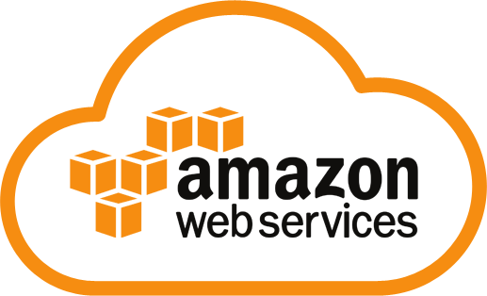
Overview of AWS

Slide 2
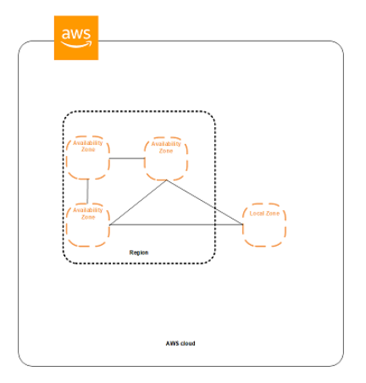
Introduction to AWS
AWS began its offering of IT infrastructure in 2006 in the form of web services i.e., now commonly known as cloud computing
AWS serves over a million active customers in more than 190 countries
Regions and Availability zones
The AWS Cloud infrastructure is built around AWS Regions and Availability Zones.
Region is a Geographic area
Each region has multiple isolated locations known as availability zones
Availability Zones consist of one or more discrete data centers
As of now AWS spans 25 regions and 81 availability zones.
A Local Zone is an AWS infrastructure deployment that places selected services closer to your end users. Each AWS Local Zone location is an extension of an AWS Region that is in a different location from your Region.

Slide 3
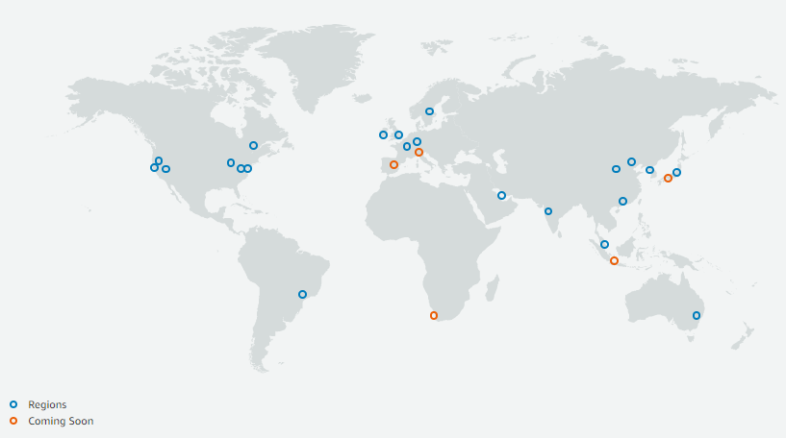
Global Infrastructure
Infrastructure of AWS
https://www.infrastructure.aws/

Slide 4
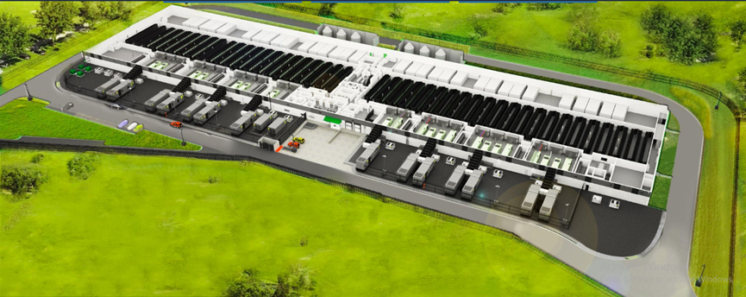
AWS Datacenter
Layers of Security
Perimeter layer
Infrastructure layer
Data layer
Environmental layer

Slide 5
Security
The AWS Cloud enables a shared responsibility model. While AWS manages security of the cloud, you are responsible for security in the cloud
The provider must ensure that their infrastructure is secure, while the user must take measures to fortify their application and use strong passwords and authentication measures.
Benefits of AWS Security
Keep your data safe
Meet your compliance requirements
Save money
Scale quickly

Slide 6
AWS Cloud Platform
AWS consists of many cloud services that you can use in combinations tailored to your business or organizational needs
To access the services, you can use
AWS Management Console
Command Line Interface (CLI)
Software Development Kits (SDKs)

Slide 7
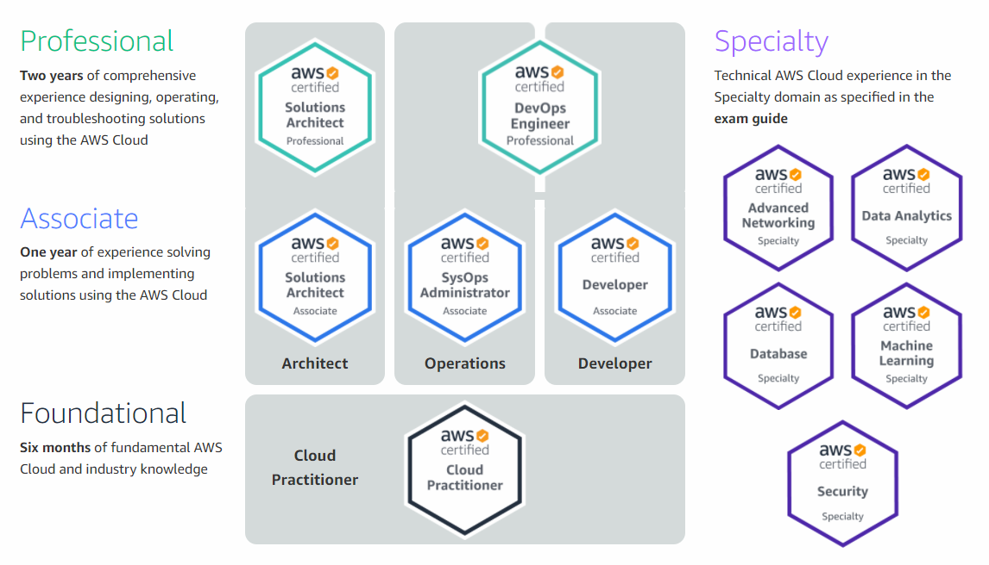
Available AWS Certifications

Slide 8


